Slide 1

Exam AZ-500: Microsoft Azure Security Technologies Crash Course
Tim Warner

Slide 2

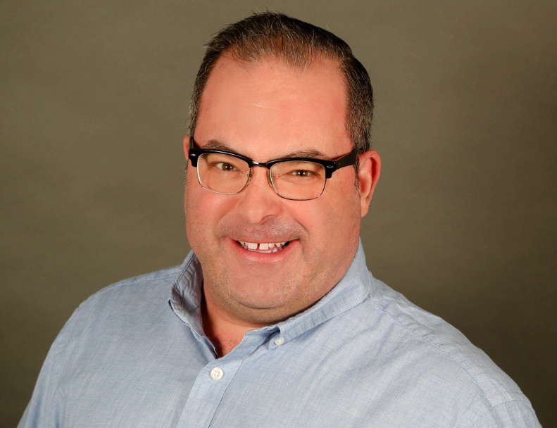
Tim Warner
Based in Nashville, TN, US
Central time zone
MCT, MVP
Twitter: @TechTrainerTim
Badge: TechTrainerTim.com

Slide 3
Course Materials
timw.info/az500

Slide 4
Session 1 of 2 Learning Goals
Introduction
Manage identity and access
Secure data and applications

Slide 5
Session 2 of 2 Learning Goals
Implement platform protection
Manage security operations

Slide 6
Setting Expectations
Let's avoid slide show fatigue
We'll learn by doing – at least 80 percent demo
Case study/scenario approach
10-minute break at midpoint
I’m here to answer your questions – take advantage of this!
Use the Q&A panel

Slide 7

Session Recordings

Slide 8

Session Recordings

Slide 9

Session Recordings

Slide 10


Mobile Browser: learning.oreilly.com

Slide 11



O'Reilly Mobile App

Slide 12
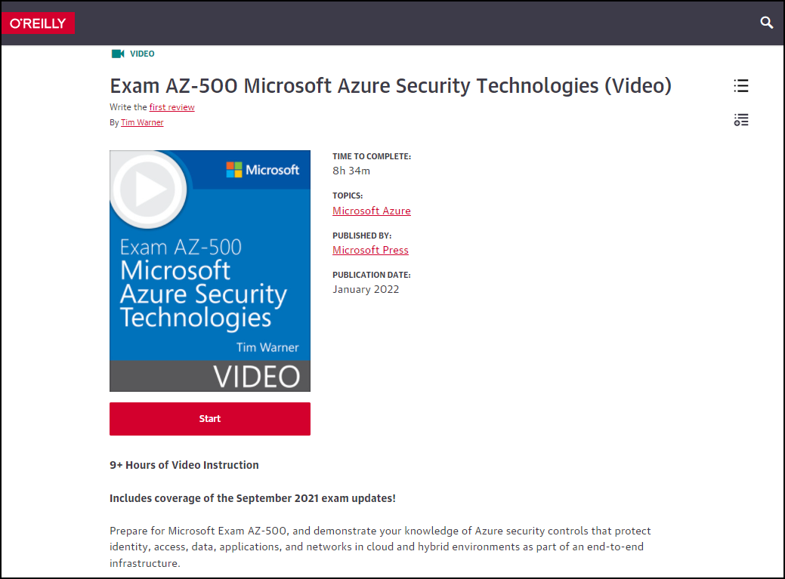
AZ-500 Video Course (MS Press)
timw.info/msp500

Slide 13
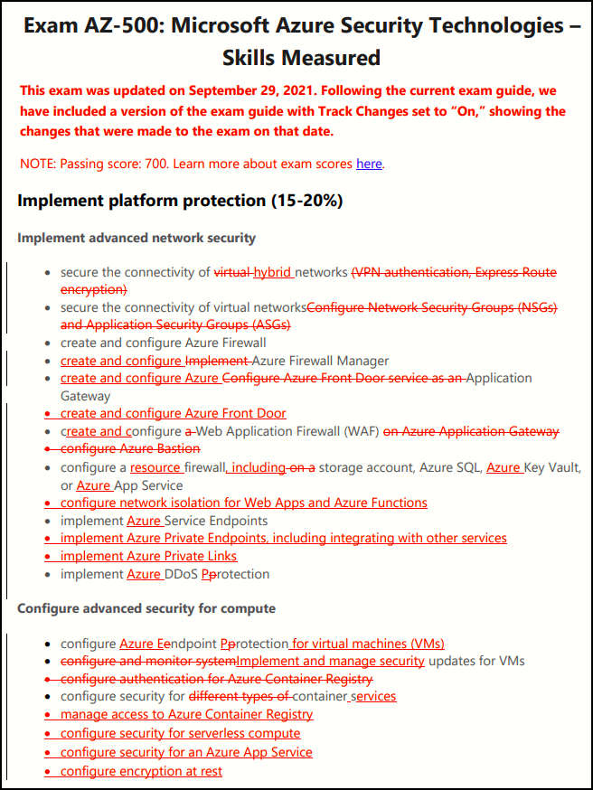
AZ-500 Changes: September 29, 2021

Slide 14
Certification Renewal
Associate and Expert certs are valid for one year
Credential will always be on your MS transcript
At six-month mark you’ll be asked to renew
Free online assessment at Microsoft Learn
Renewal extends your certification for 365 from original achievement date

Slide 15
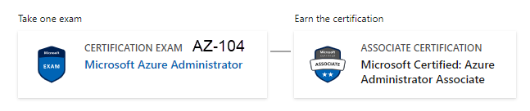
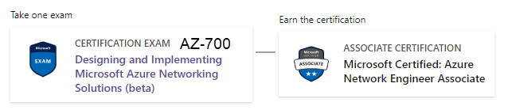

Related Certifications

Slide 16

Tim's "Tower Bridge" Certification Study Model

Slide 17
Thank you!
Course materials: timw.info/az500
Twitter: @TechTrainerTim
Work: timw.info/ps
Web: TechTrainerTim.com

Slide 18
Manage Identity and Access

Slide 19
AAA Model
Authentication
Identity verification
Authorization
Access scope
Accounting
Successful and failed AuthN and AuthZ attempts

Slide 20
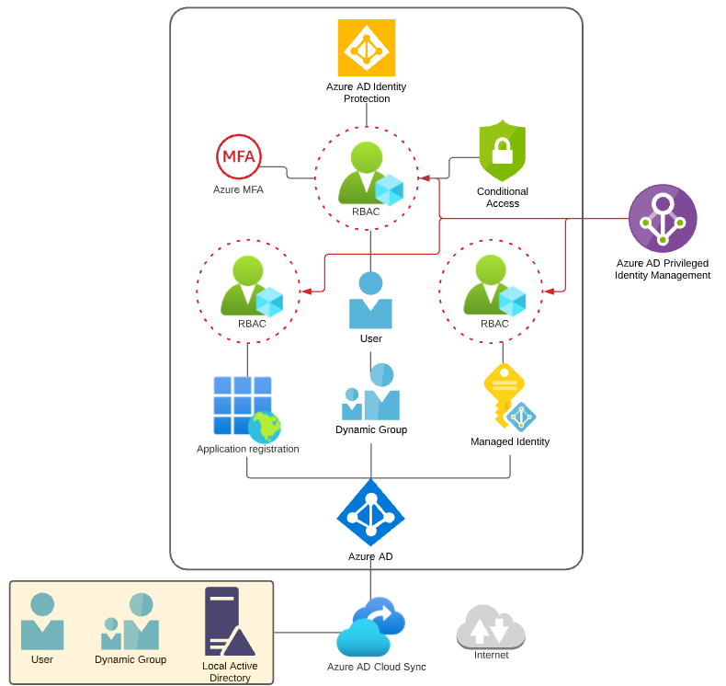
Identity and Access Scenario

Slide 21

Tenant vs. Subscription

Slide 22

Hybrid Identity

Slide 23

Azure Management Scopes
/ Tenant Root

Slide 24
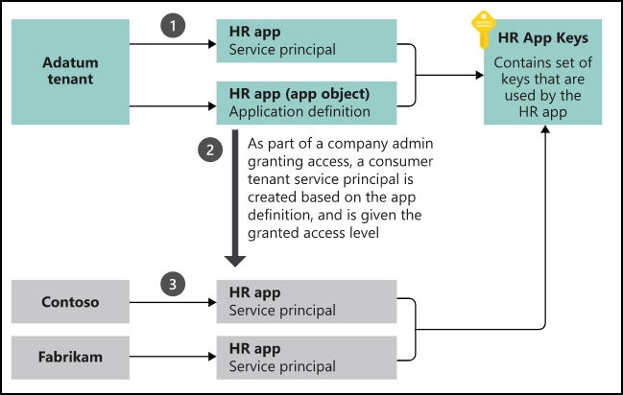
App Registrations & Service Principals

Slide 25


Azure AD B2C

Slide 26

Azure AD Domain Services

Slide 27
Azure AD Connect

Slide 28

Passthrough Authentication

Slide 29

ADFS Federation

Slide 30
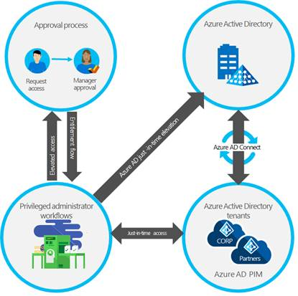
Azure AD PIM

Slide 31
Implement Platform Protection

Slide 32
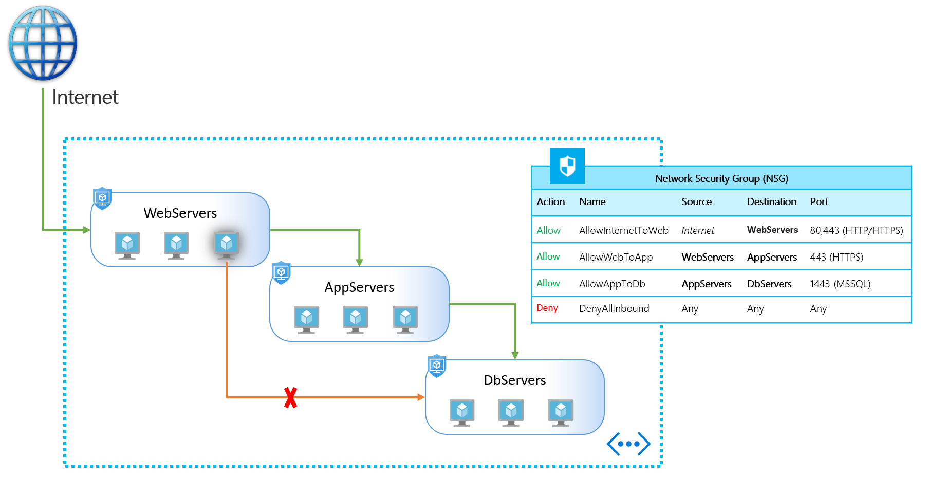
NSGs and ASGs

Slide 33

Multi-Region High Availability

Slide 34

Multi-Region High Availability

Slide 35
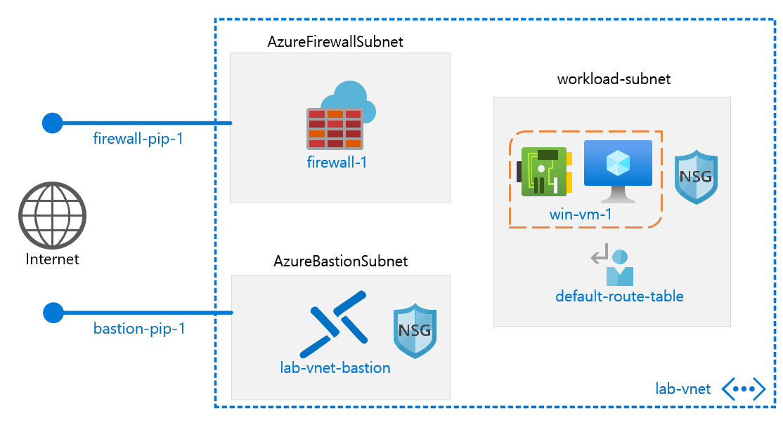
Azure Firewall

Slide 36
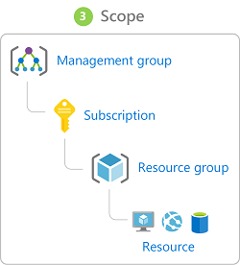
Management Scopes
/ Tenant Root

Slide 37

Service endpoints

Slide 38
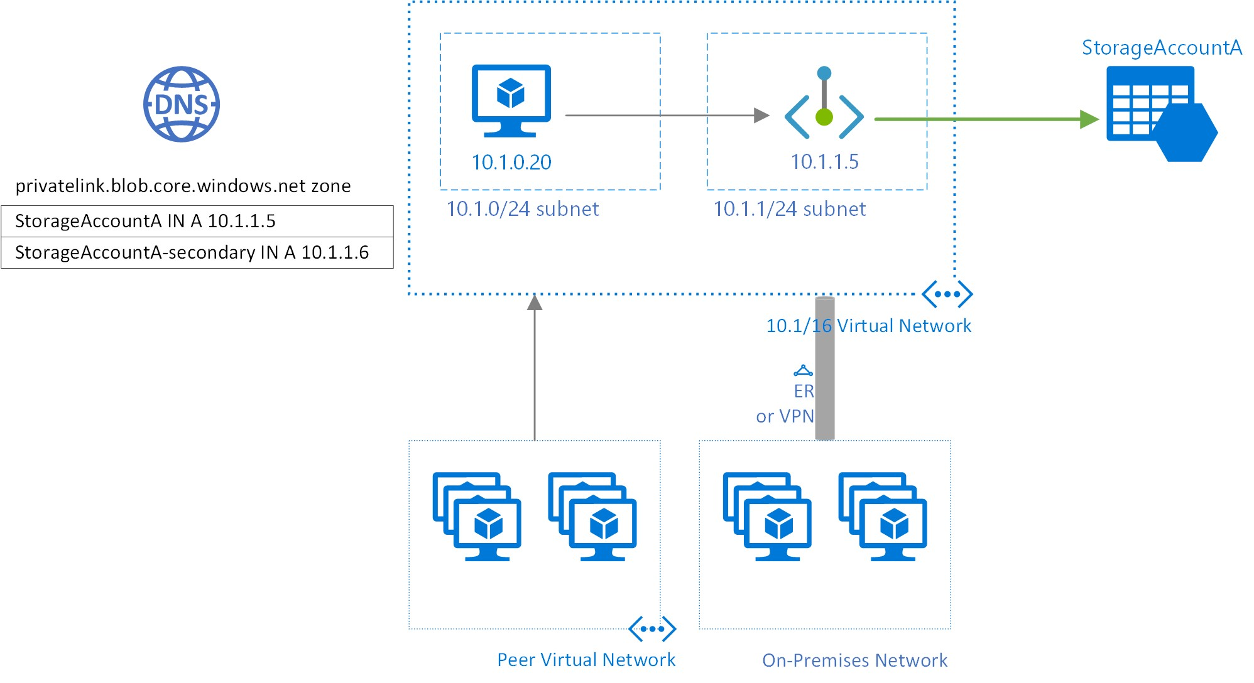
Private endpoints

Slide 39
Compute and Networking

Slide 40
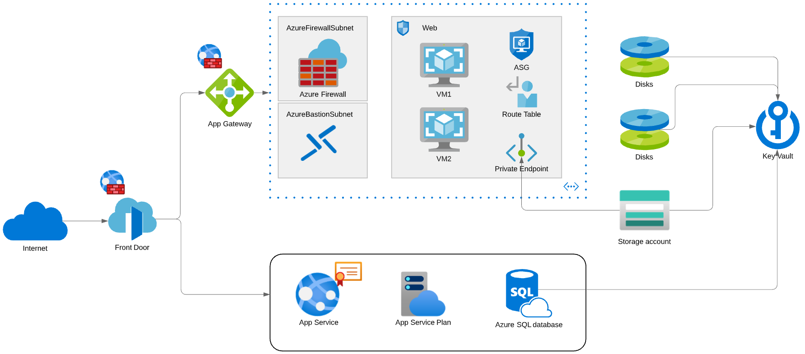
Compute and Networking Scenario

Slide 41
Manage Security Operations

Slide 42
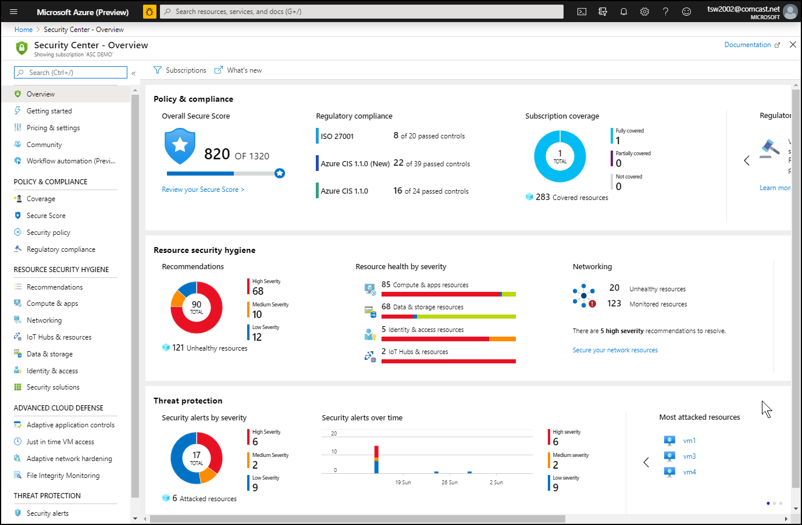
Azure Security Center

Slide 43
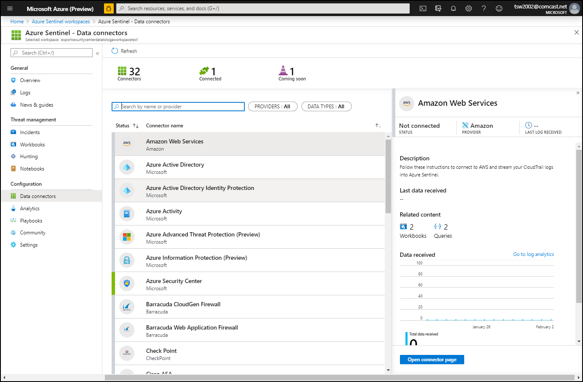
Azure Sentinel

Slide 44
Secure Data and Applications

Slide 45
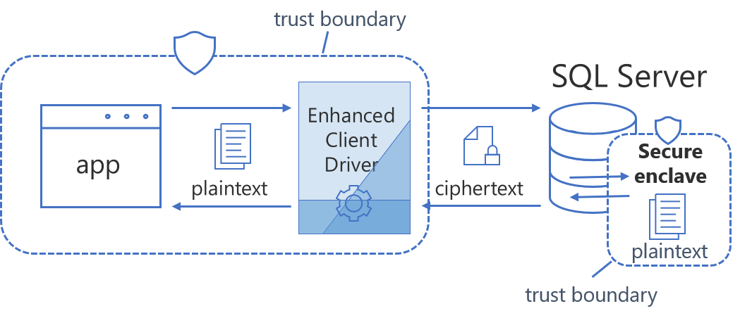
Always Encrypted

Slide 46
Security Operations

Slide 47
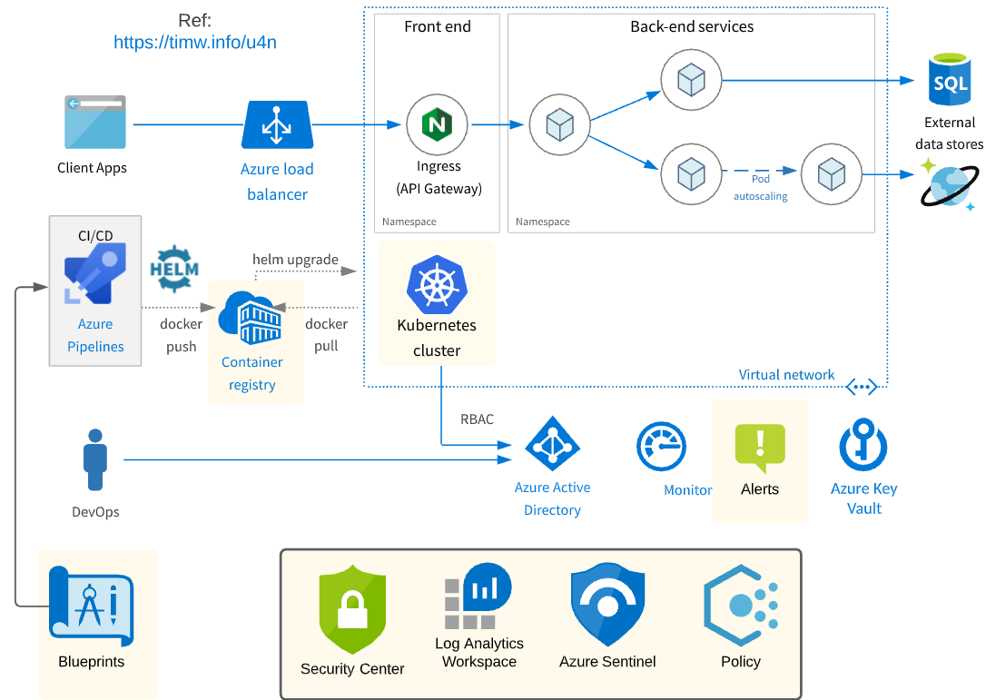
Security Operations Scenario

Slide 48
Exam AZ-500 Item Types

Slide 49

Single Answer Multiple Choice

Slide 50

Multiple Answer Multiple Choice

Slide 51
Repeated Scenario
You need to move an Azure VM to another hardware host.
Solution: You redeploy the VM.
Does this solution meet the goal?
Yes
No

Slide 52
Repeated Scenario
You need to move an Azure VM to another hardware host.
Solution: You enable boot diagnostics.
Does this solution meet the goal?
Yes
No

Slide 53

Select and Place

Slide 54

Build List and Reorder

Slide 55

Active Screen

Slide 56

Case Study

Slide 57






Performance-Based Testing

Slide 58
Microsoft Online Testing

Slide 59
Microsoft Online Testing Process
timw.info/online

Slide 60

Microsoft Online Testing Process

Slide 61

Microsoft Online Testing Process

Slide 62

Microsoft Online Testing Process

Slide 63

Microsoft Online Testing Process

Slide 64

Microsoft Online Testing Process

Slide 65

Microsoft Online Testing Process

Slide 66

Microsoft Online Testing Process

Slide 67
AZ-500 Exam Strategy
Focus your skills accordingly:
60 percent Azure portal
20 percent Azure PowerShell
10 percent Azure CLI
10 percent KQL
Azure AD PIM all day long
Expect performance-based labs, but be happy if you don't see 'em

Slide 68
Parting Advice
Check out my YouTube (timw.info)
Online testing
Cert item strategy
AZ-500 study guide
Invest in Whizlabs or MeasureUp
Register for your exam ASAP!

Slide 69
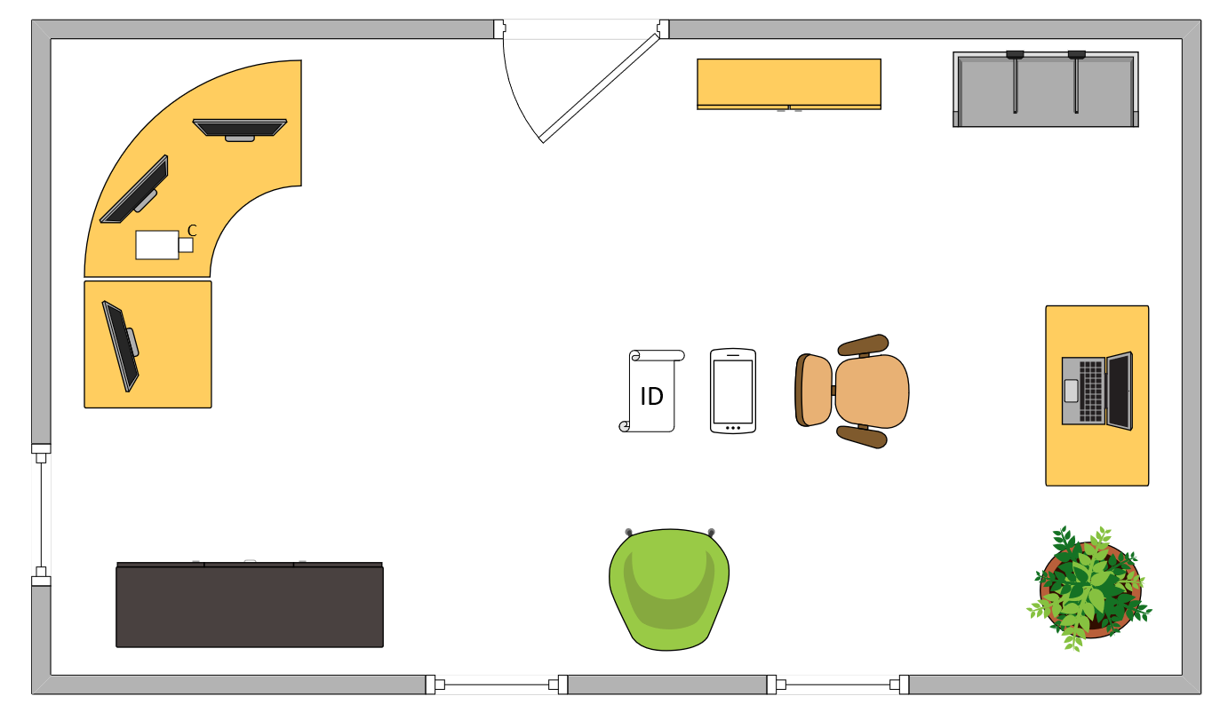

Tim’s Ideal Testing Room
No interruptions or bio breaks
Cover monitors and cameras
Pull back for environment photos
Clear table with laptop

Slide 70
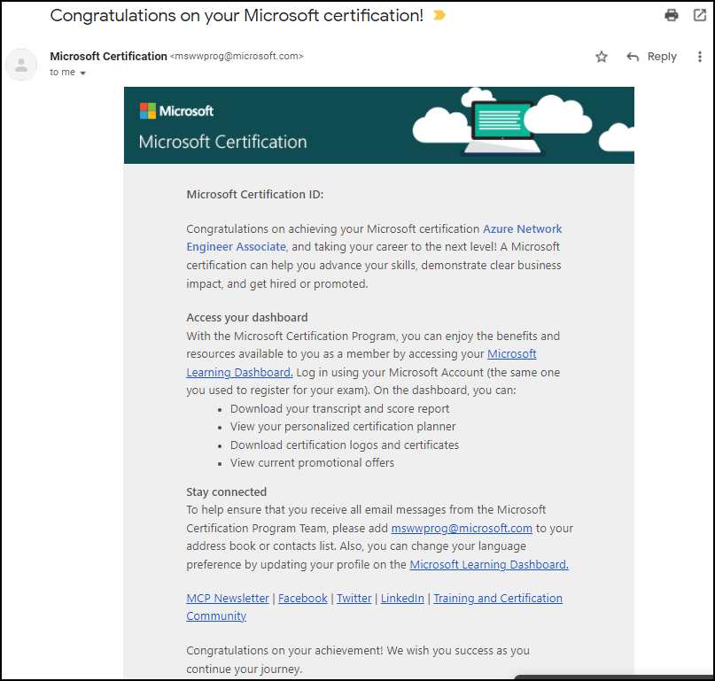
Congratulations!

Slide 71
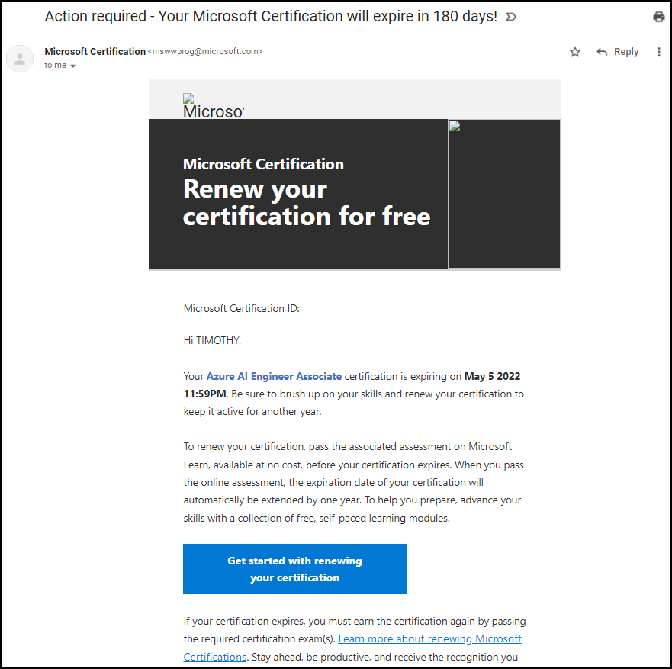
Certification Renewal

